Slide 1
ZOMBIE ATTACK!

Slide 2
Wanted:

Slide 4
1
2
3
4
5
6
7
8
9
10
11
12
13
14
15
16
17
18
19
20

Slide 5
Question
1
2 cosx – 1 = 0
Answer

Slide 6
Answer
1
π/3, 5π/3

Slide 7
Question
2
3tan²x = 1
Answer

Slide 8
Answer
2
π/6, 5π/6, 7π/6, 11π/6

Slide 9
Question
3
Sin2x=1/2
Answer

Slide 10
Answer
3
π/12,13π/12, 5π/12, 17π/12

Slide 11
Question
4
2cos²x –cosx-1=0
Answer

Slide 12
Answer
4
2π/3, 4π/3,0

Slide 13
Question
5
cosx=cosxsinx
Answer

Slide 14
Answer
5
π/2,3π/2

Slide 15
Question
6
sinx = cosx
Answer

Slide 16
Answer
6
π/4, 5π/4

Slide 17
Question
7
$$sin\frac{θ}{2}=\frac{\sqrt{3}}{2}$$
Answer

Slide 18
Answer
7
2π/3, 4π/3

Slide 19
Question
8
cscx = 2
Answer

Slide 20
Answer
8
π/6, 5π/6

Slide 21
Question
9
π/3, 5π/3, π/2
Answer

Slide 22
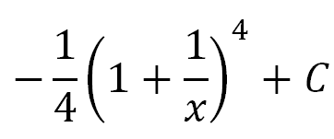
Answer
9

Slide 23
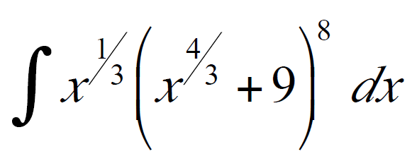
Question
10
Answer

Slide 24
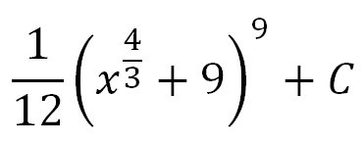
Answer
10

Slide 25
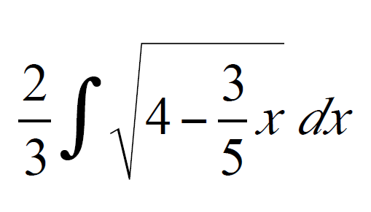
Question
11
Answer

Slide 26
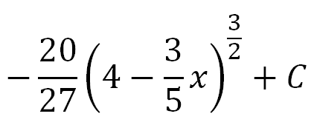
Answer
11

Slide 27
Question
12
Answer

Slide 28
Answer
12

Slide 29
Question
13
Answer

Slide 30
Answer
13
0

Slide 31
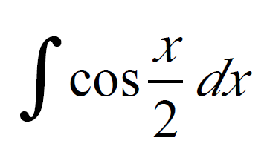
Question
14
Answer

Slide 32
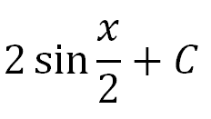
Answer
14

Slide 33
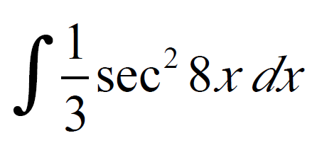
Question
15
Answer

Slide 34
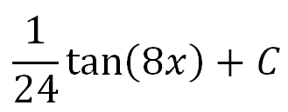
Answer
15

Slide 35
Question
16
Answer

Slide 36
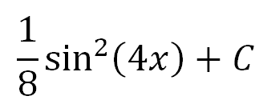
Answer
16

Slide 37
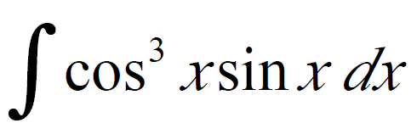
Question
17
Answer

Slide 38
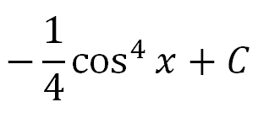
Answer
17

Slide 39
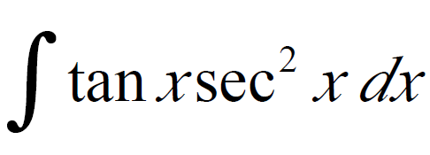
Question
18
Answer

Slide 40
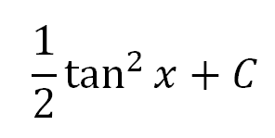
Answer
18

Slide 41
Question
19
Answer

Slide 42
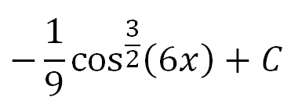
Answer
19

Slide 43
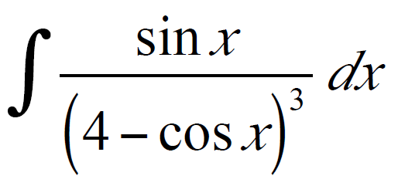
Question
20
Answer

Slide 44
Answer
20

